Slide 1
Case Study: Denver International Airport Baggage Handling System
Name: Radhika Bailurkar
UID: 2019430003

Slide 2
Introduction
This study concerns the automated baggage handling system which was built by BAE Automated Systems, Incorporated of Carrollton, Texas for the Denver International Airport.
From the baggage system's failure, principles of computer systems were clarified and many lessons were learned or relearned by those involved in the BAE project.
While there are a variety of issues to learn from the many operations in the construction of the Denver International Airport, focus is placed on the baggage system itself.

Slide 3
Reasons for Failure
Underestimation of Complexity
Change in Strategy
Decision to Proceed
Schedule, scope and budget commitments
Acceptance of change request
Design of the physical building structure

Slide 4
Actions to Mitigate the failure
If the DIA had planned out smaller project or increased the timeframe for the given project then it could have been functioned as it was supposed to be thus lowering the complexity.
Before implementing new changes, the previous module should have been tested and integrated into the system by the project team.
The Airport’s Project team failed to see the shift in technology. Mostly, it was observed that airline teams are responsible for handling baggages rather than airport team.
Although DIA’s Project team and BAE had agreed upon the contract, the BAE should have consulted the several senior managers and experts who would have guided them rather than seeing it as an opportunity to grow business

Slide 5
Technical Specifications
Baggage Handling System
Components
Tracking Baggage
Object Oriented Architecture

Slide 6
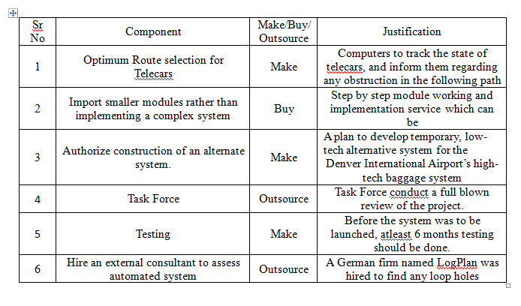
Components for make/buy/outsource

